Slide 1
Android Studio At home: L:\Applications\Android Studio\SeptUpdate run Android.exe and then androidsdk.exe https://developer.android.com/studio/archive Download at home the same version as the lab not the latest version
Android Studio 3.5

Slide 2
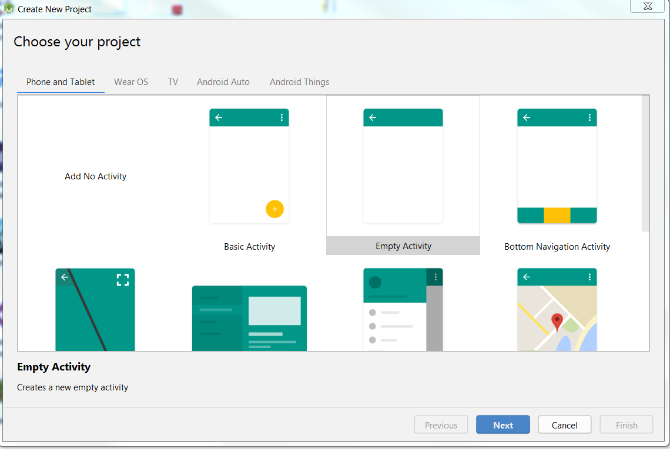

Slide 3
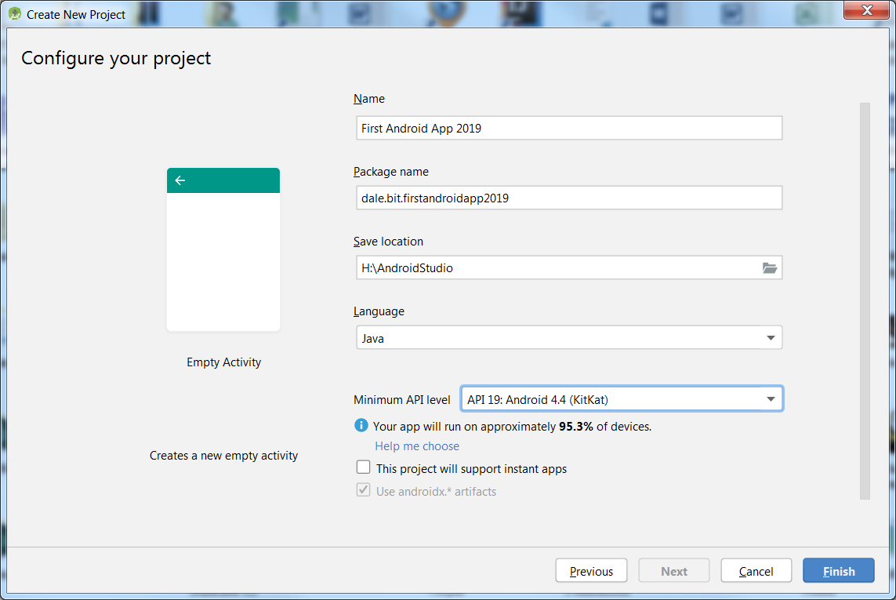

Slide 4
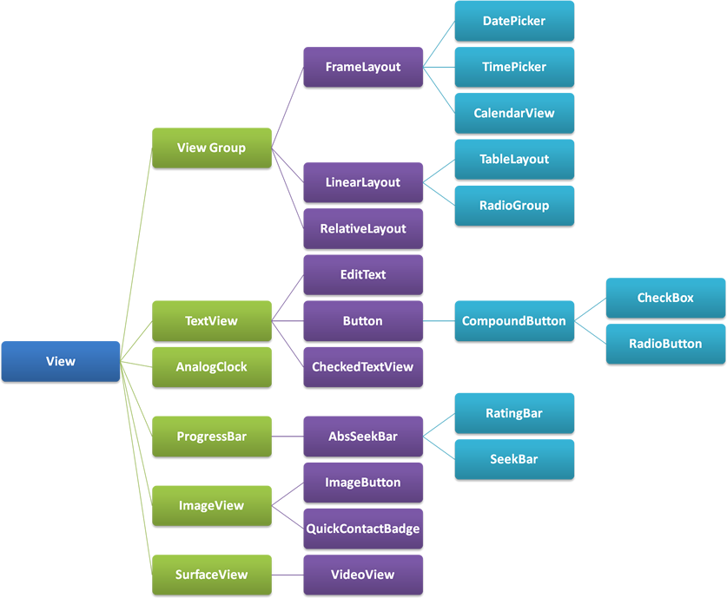
Views

Slide 5
Setting android:layout_width
match_parent | Make the same width as the containing control
wrap_content | Make as wide as needed to contain the content
“25dp” | Make the control 25 screen pixels wide
@dimen/some_resource | Set the width to the value of this resource constant.
Notes:
In this case, “match-parent” means “make this control as wide as its parent”
And “wrap content” means “make this control as high as its content.
Both of these assume adjustment for padding, which is the space between content and boundary.
There are a variety of possible units other than dp (see docs), and the value can be any floating point number.
And there are lots of other layoutish properties that you can configure to control how your controls size themselves….

Slide 6
View Attributes
Attribute | Description
android:id | This is the ID which uniquely identifies the view.
android:layout_width | This is the width of the layout.
android:layout_height | This is the height of the layout
android:layout_marginTop | This is the extra space on the top side of the layout.
android:layout_marginBottom | This is the extra space on the bottom side of the layout.
android:layout_marginLeft | This is the extra space on the left side of the layout.
android:layout_marginRight | This is the extra space on the right side of the layout.
android:layout_gravity | This specifies how child Views are positioned.
android:layout_weight | This specifies how much of the extra space in the layout should be allocated to the View.
android:layout_x | This specifies the x-coordinate of the layout.
android:layout_y | This specifies the y-coordinate of the layout.
android:layout_width | This is the width of the layout.
android:layout_width | This is the width of the layout.
android:paddingLeft | This is the left padding filled for the layout.
android:paddingRight | This is the right padding filled for the layout.
android:paddingTop | This is the top padding filled for the layout.
android:paddingBottom | This is the bottom padding filled for the layout.

Slide 7
Event Listeners
Event | Listener
Attach state change | OnAttachStateChangeListener
Click | OnClickListener
Create of context menu | OnCreateContextMenuListener
Drag | OnDragListener
Focus change | OnFocusChangeListener
Generic motion | OnGenericMotionListener
Hover | OnHoverListener
Hardware key | OnKeyListener
Layout change | OnLayoutChangeListener
Long click | OnLongClickListener
Status bar visibility change | OnSystemUiVisibilityChangeListener
Touch | OnTouchListener

Slide 8
Setting up the emulator
Tools| AVD manager

Slide 9
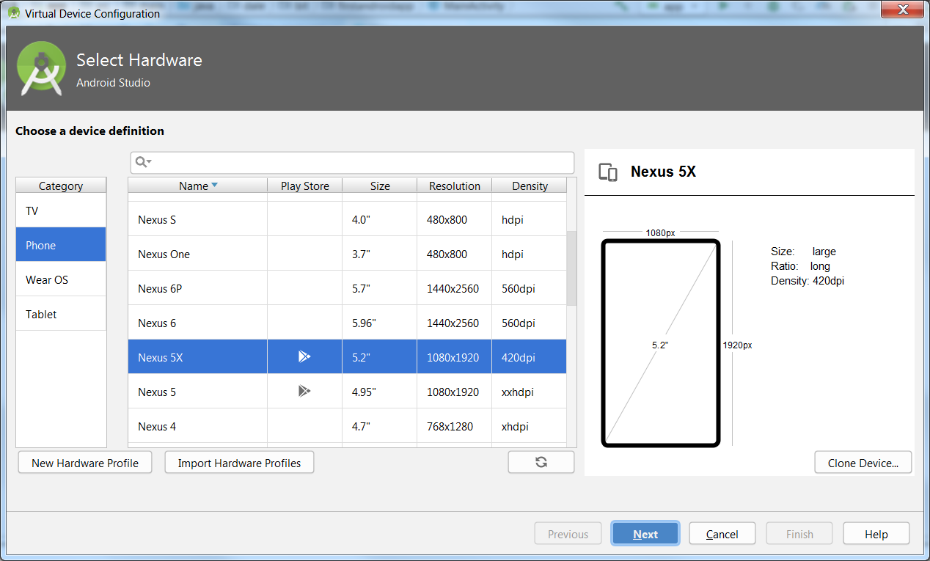

Slide 10
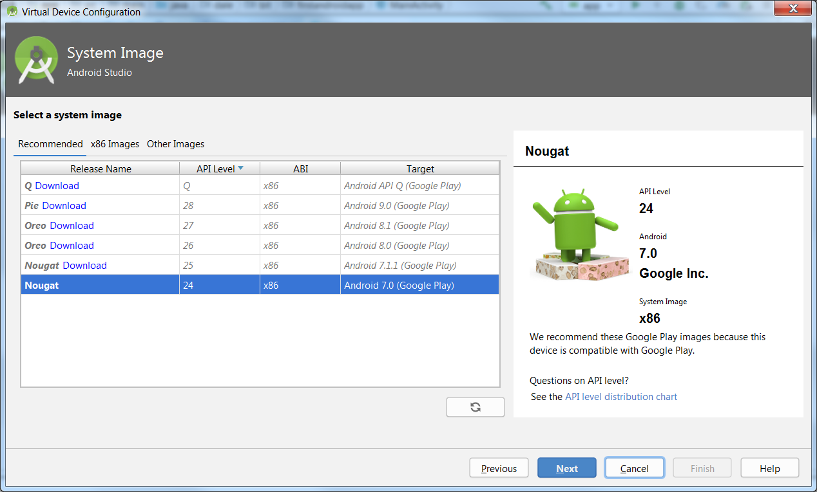

Slide 11
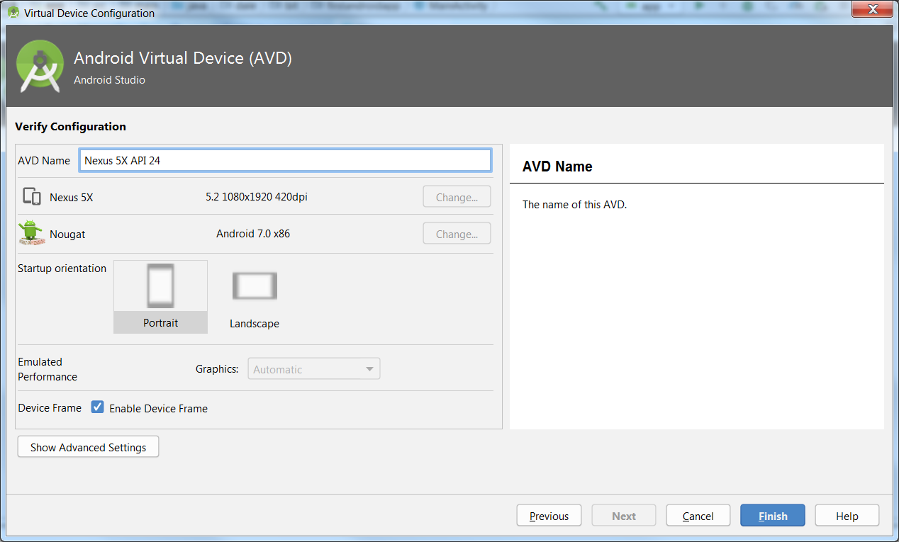

Slide 12
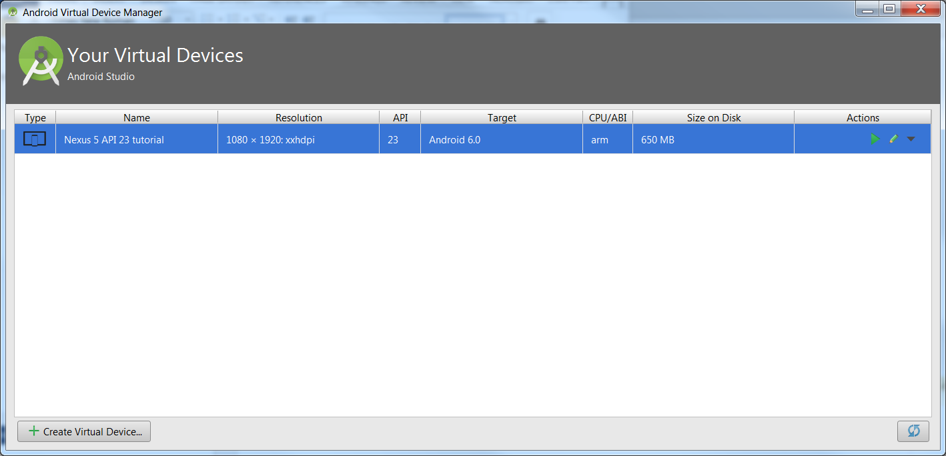
Now launch then back to main and Run - takes a while

Slide 13
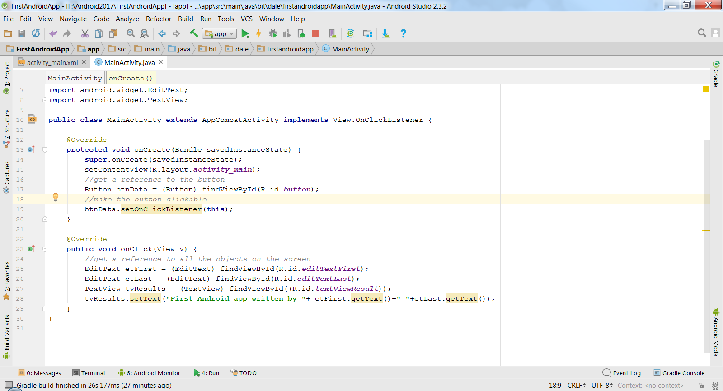
Button Handlers

Slide 14
Resources
https://developer.android.com/guide/topics/ui/layout/relative.html
Android Training - 4.5-Lay out screens with LinearLayout Android App Development
https://www.lynda.com/Android-tutorials/Using-LinearLayout-containers/442863/456767-4.html
Android Training - 4.6-Lay out screens with RelativeLayout Android App Development
https://www.lynda.com/Android-tutorials/Using-RelativeLayout-containers/442863/456768-4.html

